Slide 1




The Air Dominance Center
Savannah Combat Readiness Training Center (CRTC)
Senior Leader Brief

Slide 2
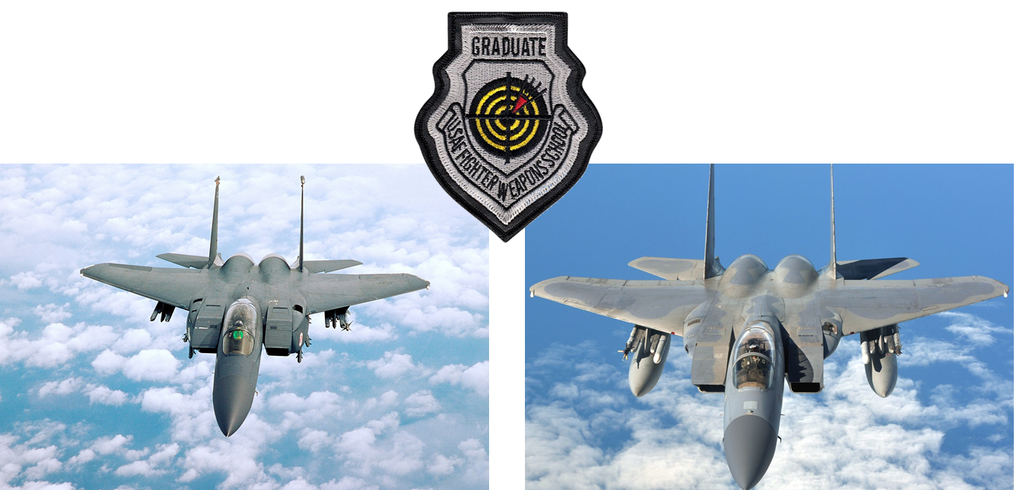
Introduction
Col Stephen “Tracker” Thomas
Commander - ADC

Slide 3
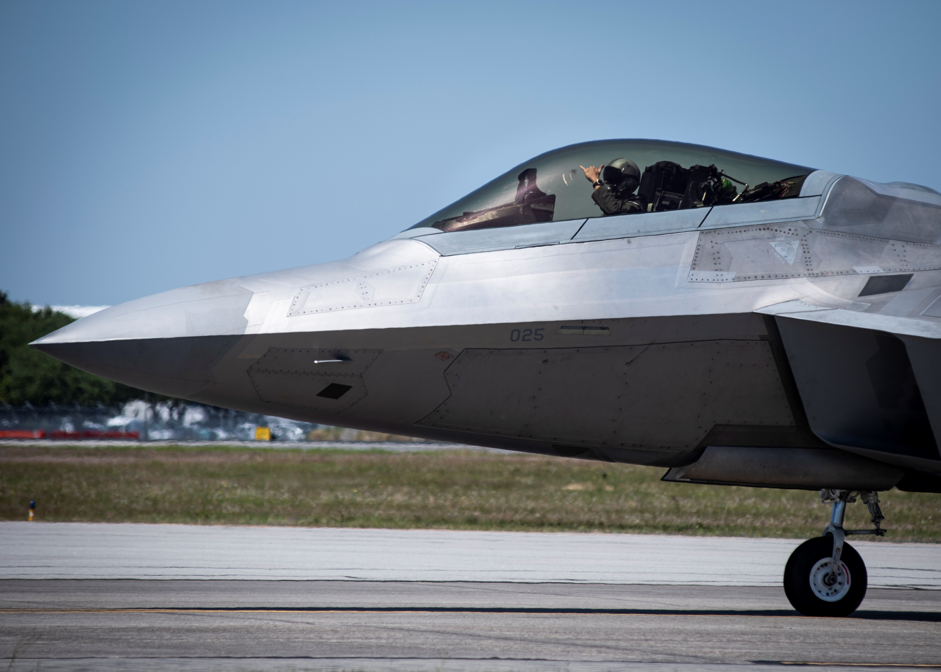
Objectives
Local Community Engagement
Awareness and Advocacy
Savannah CRTC vs Air Dominance Center
Unite Savannah as the “Home of the Warfighter”
Why Savannah has become the greatest place in the DOD to
Train for tomorrow’s fight, today!
Airspace
Vault Space
Naval Integration

Slide 4
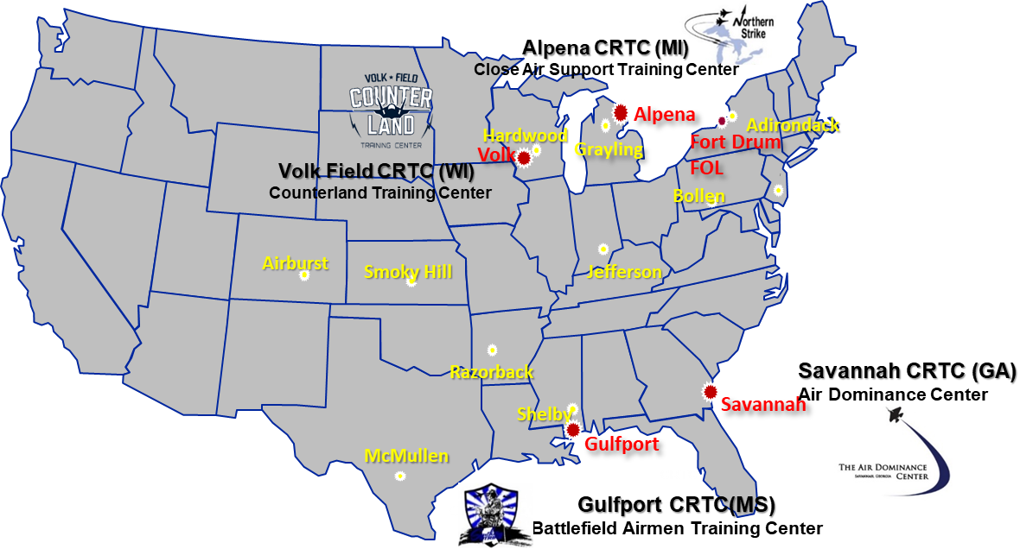
CRTC Concept
National Guard Bureau
Combat Readiness Training Center (CRTC)
4 CRTC - funded by the National Guard Bureau
Alpena CRTC (MI)
Volk Field CRTC (WI)
Gulfport CRTC (MS)
Savannah CRTC (GA)
The Air Dominance Center:
34 AGR (Full Time)
34 DSG (Part Time)
29 Appendix
3 Title 5
22 Contractors

Slide 5
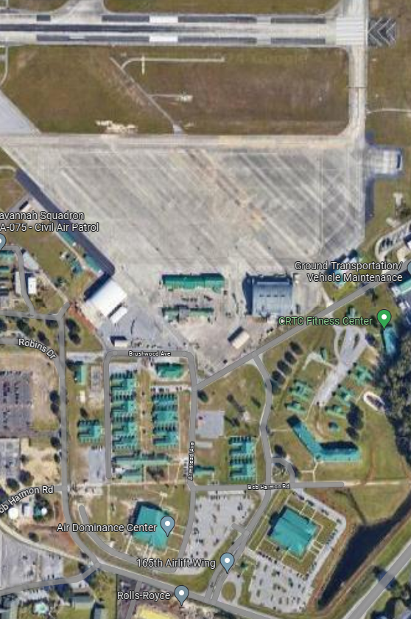
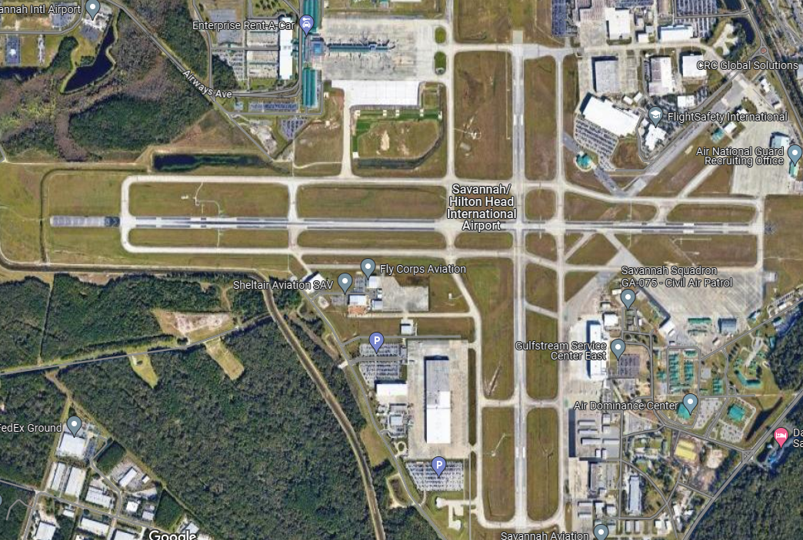
Savannah CRTC

Slide 6
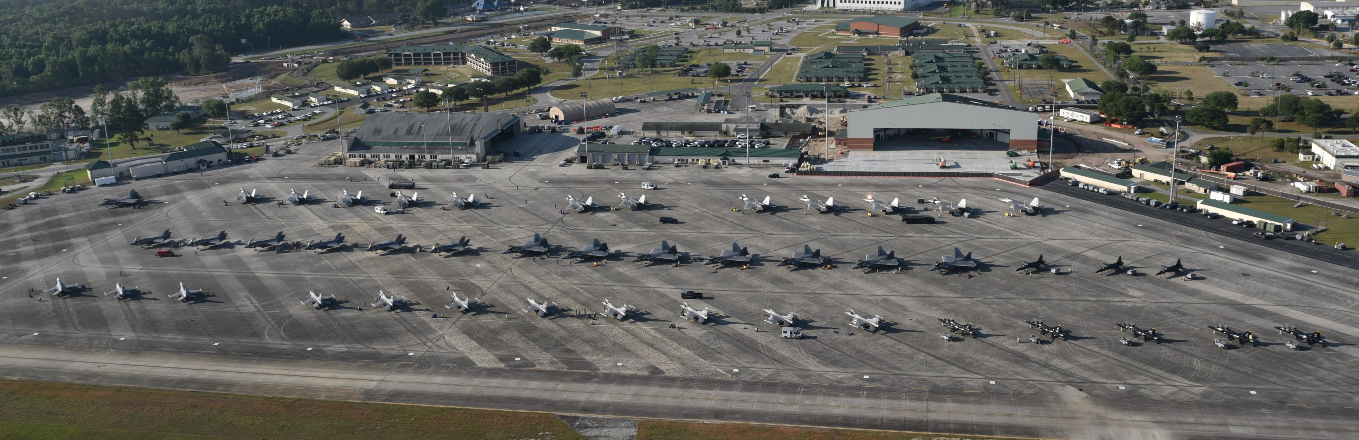
The Air Dominance Center
Flying Training
Airspace - 230 NM x 175 NM, SFC – 60,000ft
Vault Facilities – 7,300+ sq/ft
Ramp – 54 aircraft, new $25M hangar
Ground Training
Conference Center – 7,800 sq/ft
Lodging – 704 beds
DFAC – projected $27M MILCON project

Slide 7
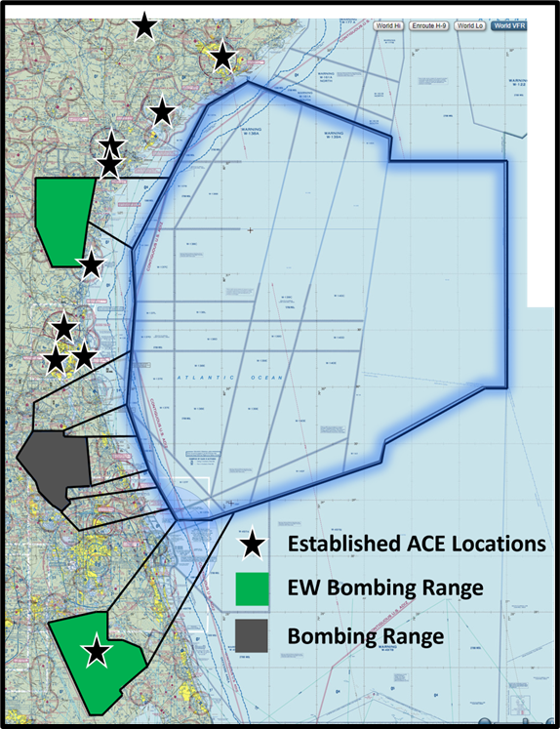
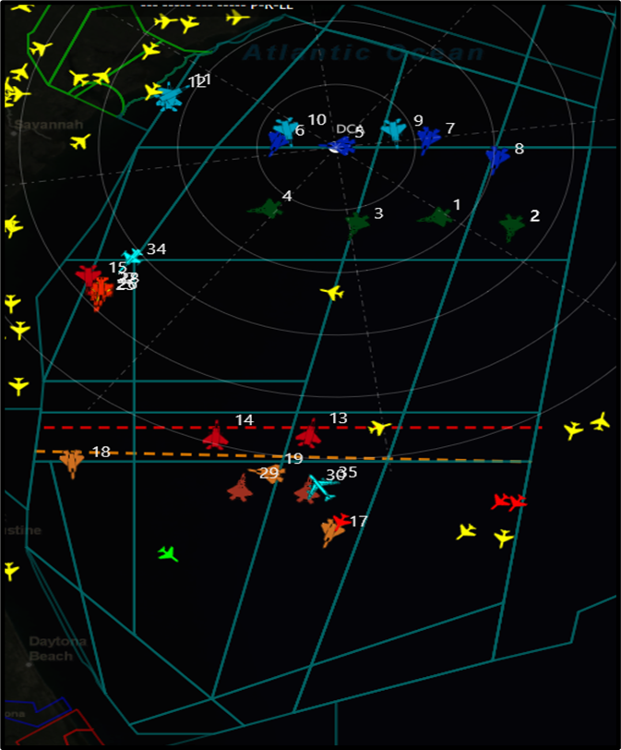
The Air Dominance Center
Airspace
Zero cost
230 NM x 175 NM, SFC – 60,000ft
Supersonic, Chaff and Flare
Red and Blue tactics
Embedded dissimilar combat

Slide 8
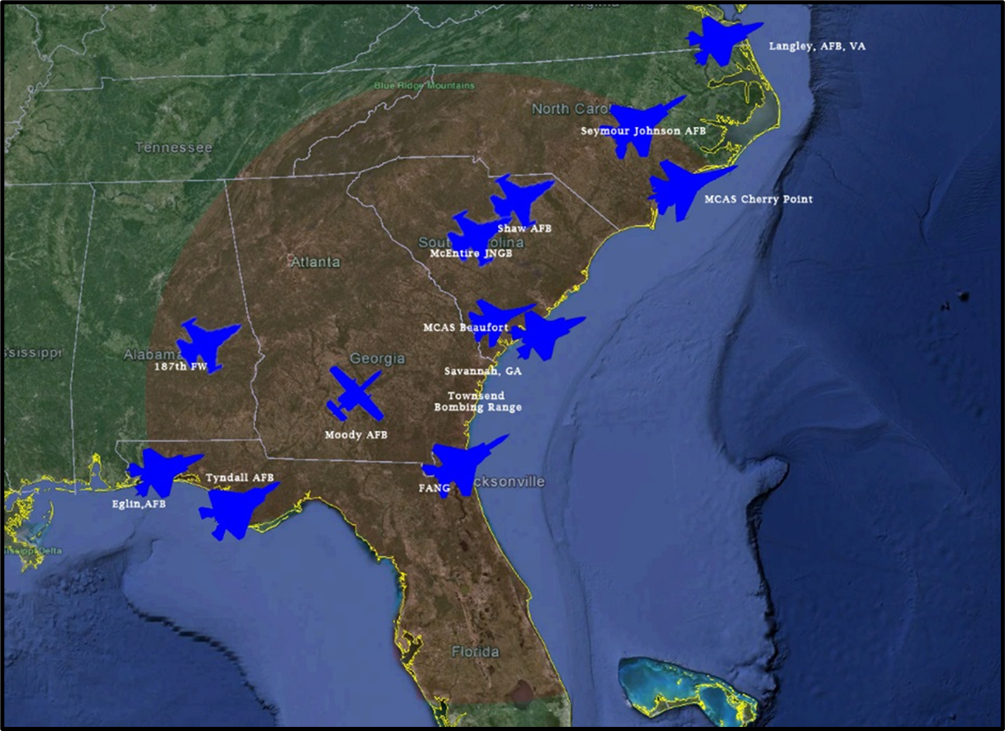
The Air Dominance Center
Strategic Location
33 Fighter Squadrons within 450 miles
Highest density of 5th Generation stealth fighters in the world
3 Naval Bases within 150 miles
Unique mission sets:
Counter Air
Counter Sea
Agile Combat Employment
Co-located – 165AW – C-130J

Slide 9
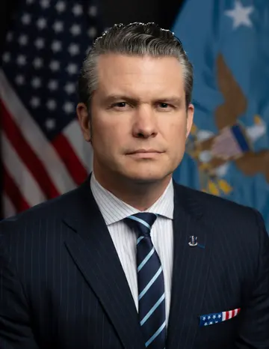
Secretary of War
Train Warriors!
“We must train and we must maintain. Any moment that we are not training on our mission or maintaining our equipment is a moment we are less prepared for preventing or winning the next war.”

Slide 10
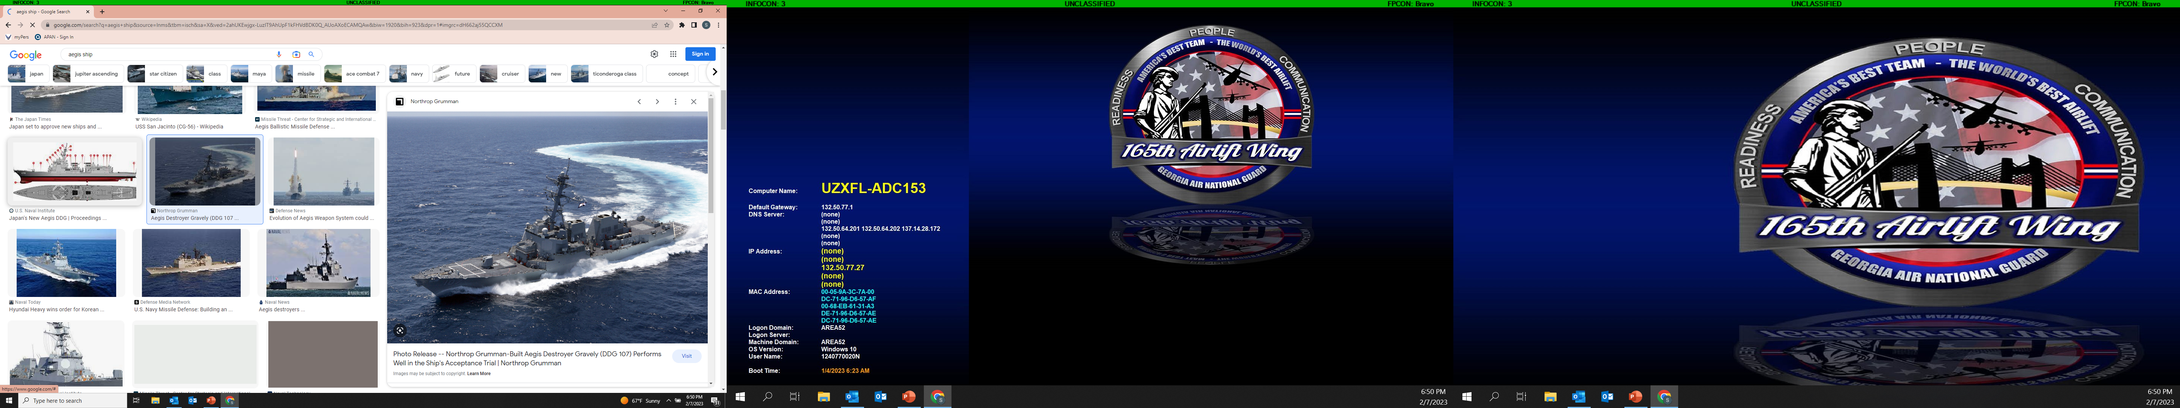
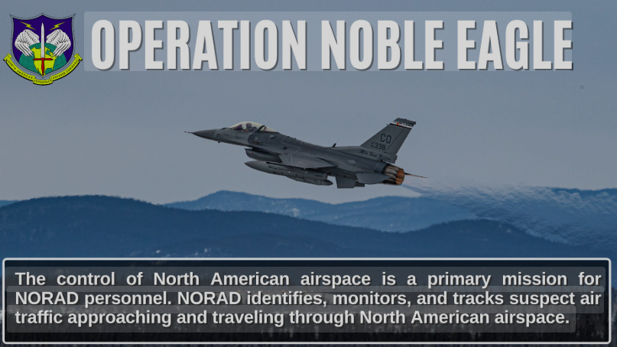
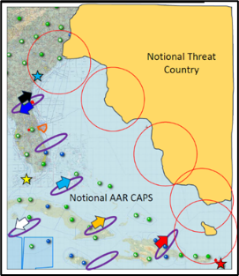
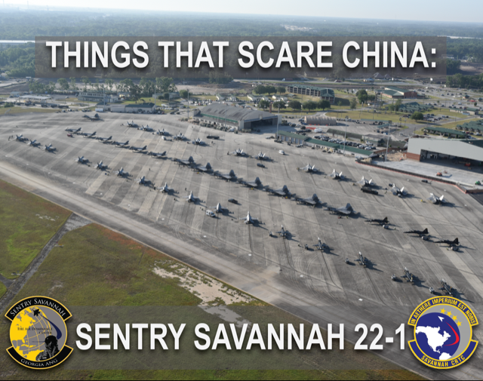
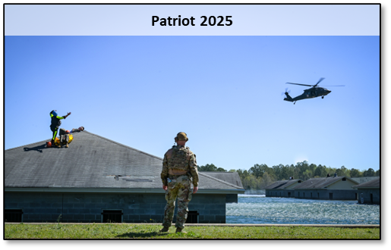
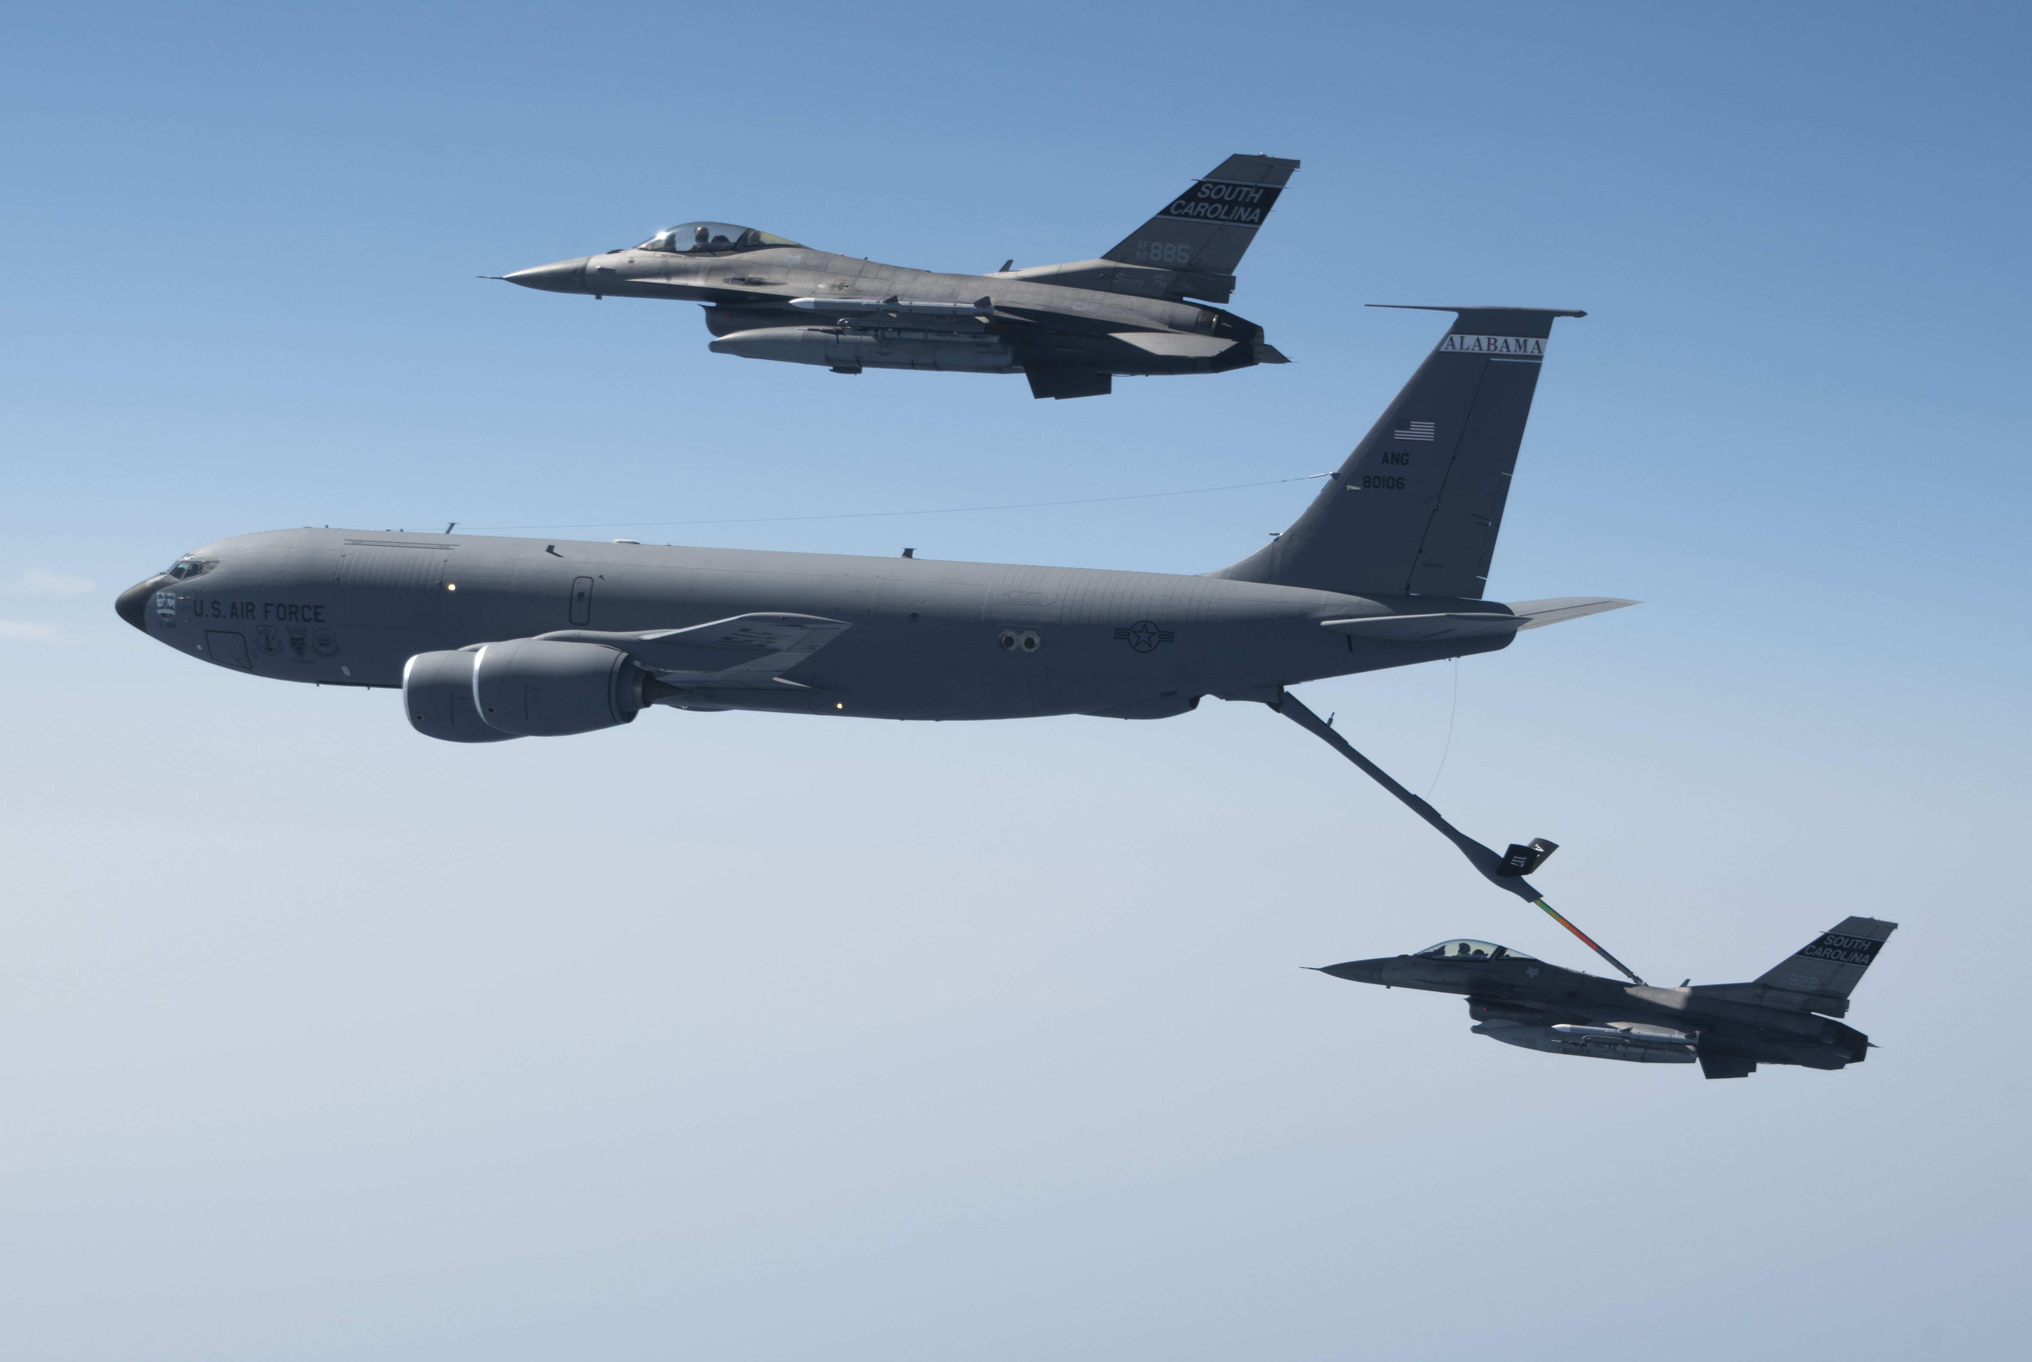
National Defense Strategy
Defend the Homeland
Deter Strategic Attack
Maverick Armistice 2025
$110+M annual flying training

Slide 11
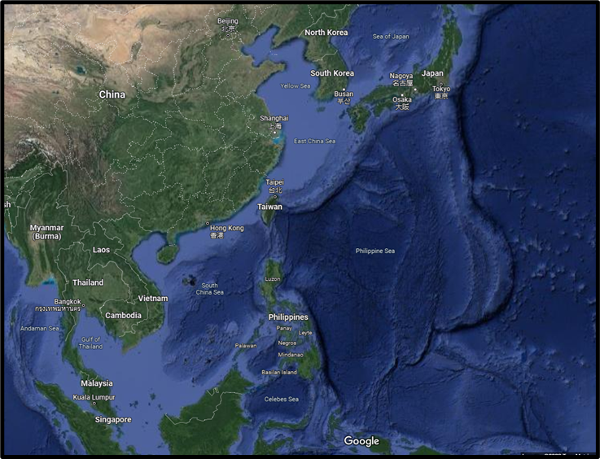
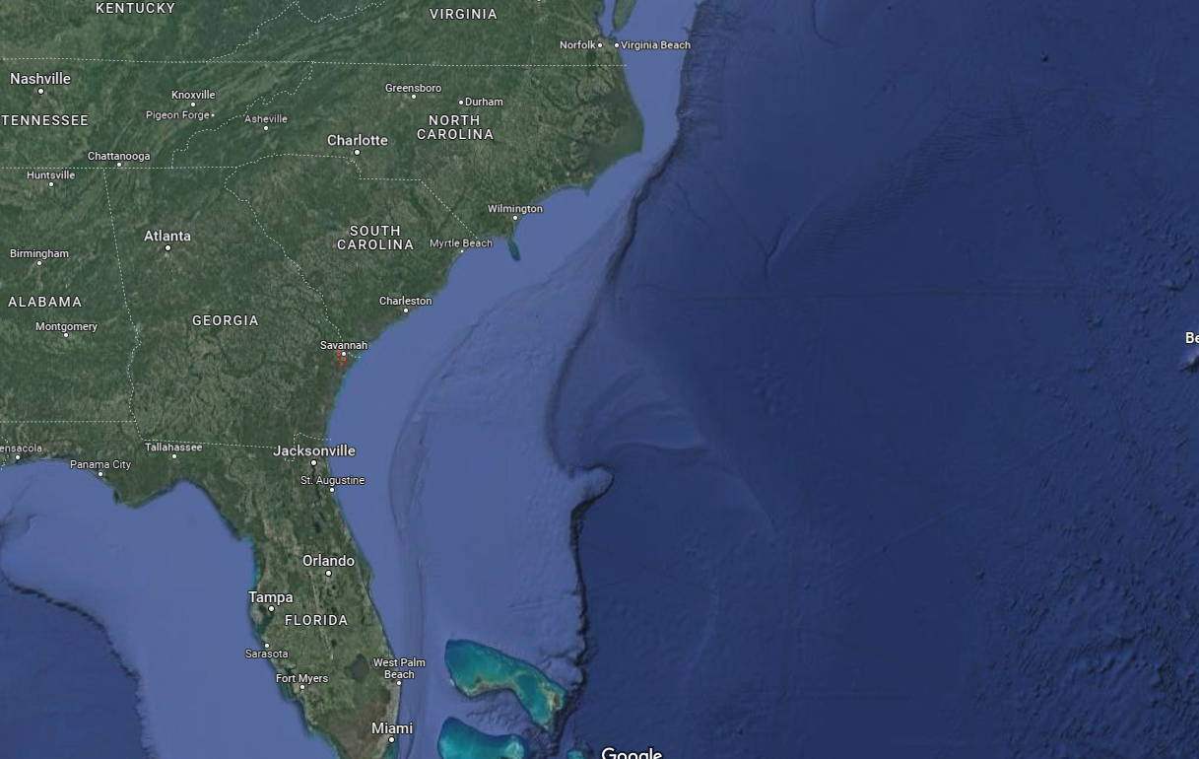
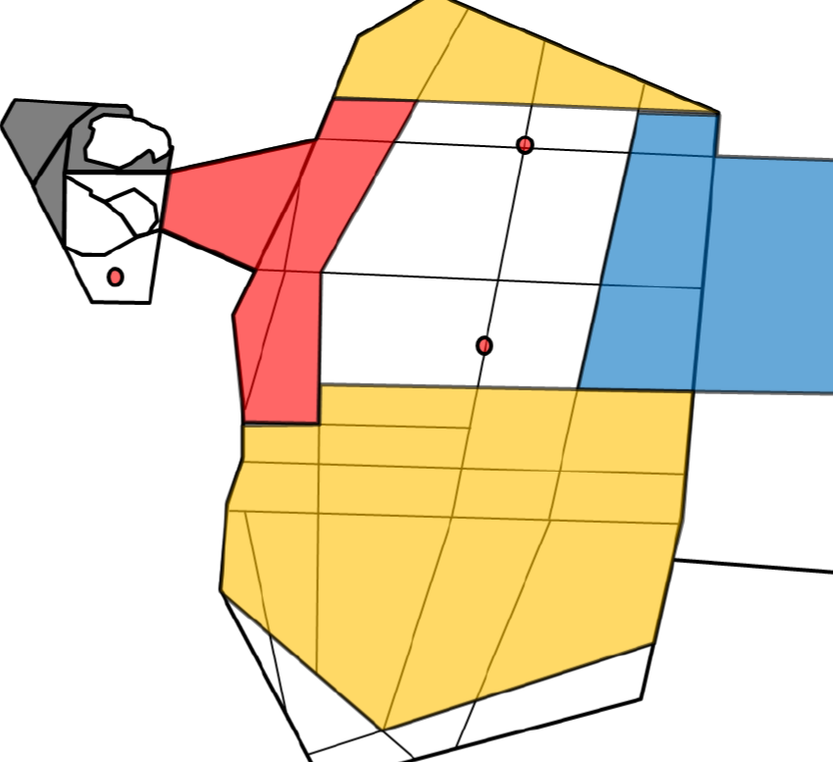
Battlespace Relevance

Slide 12
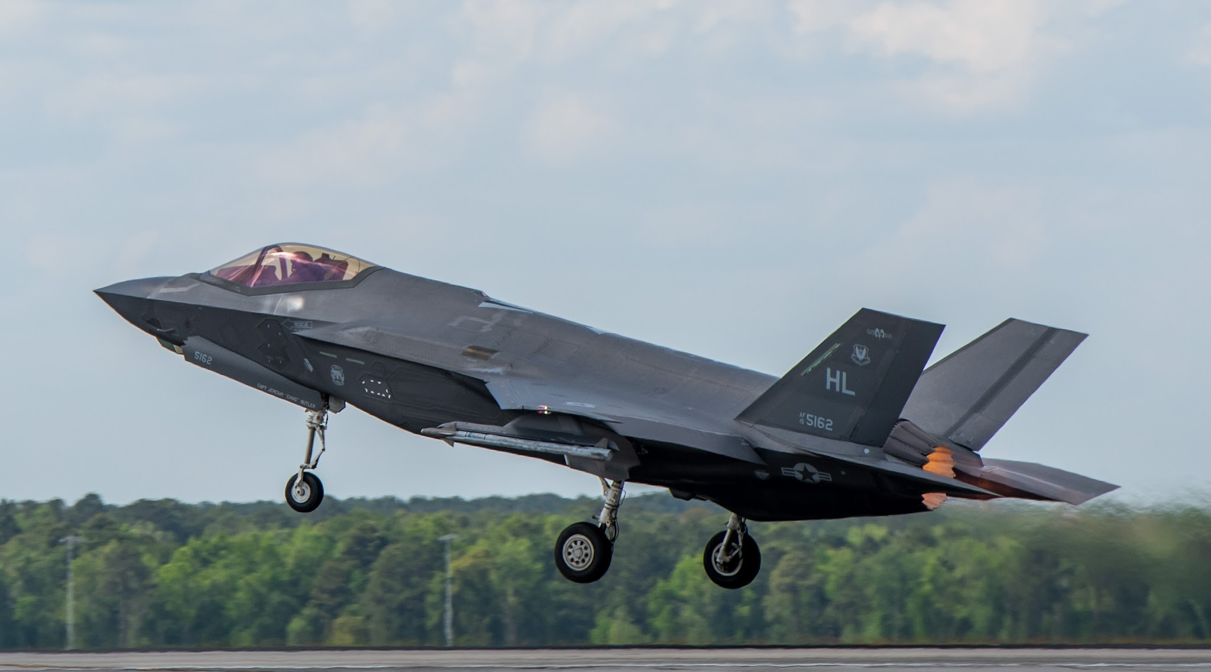
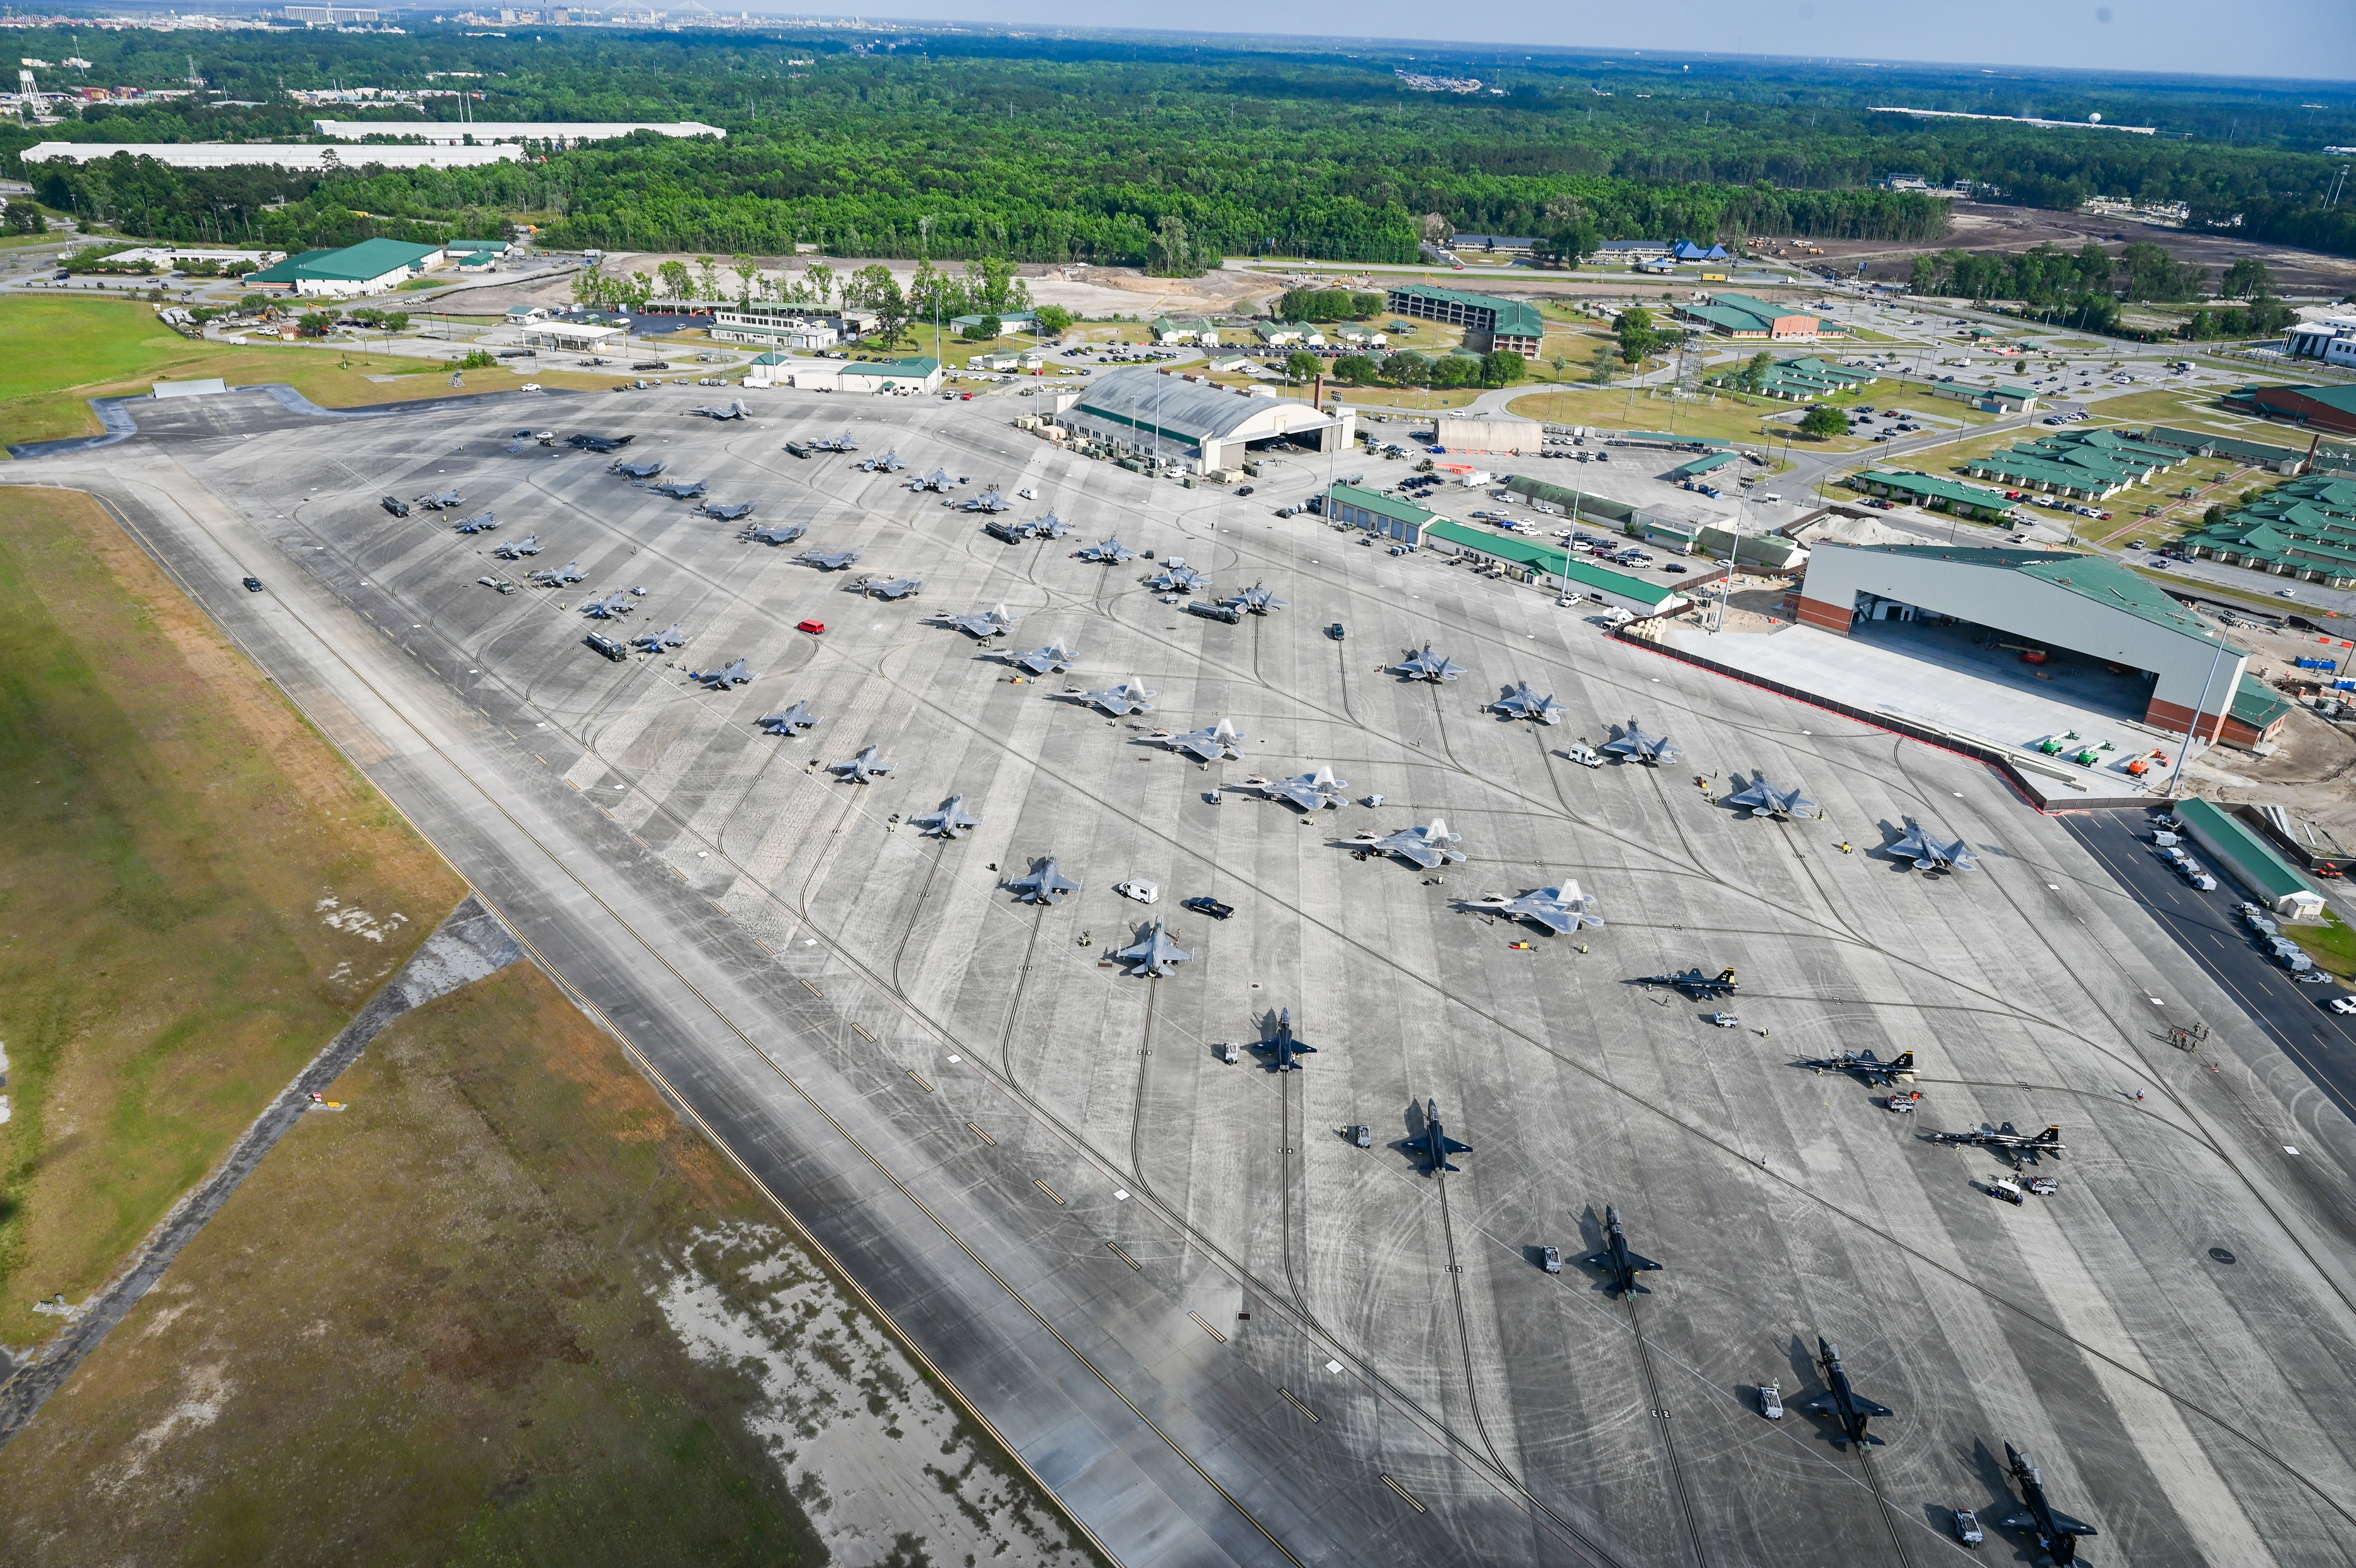
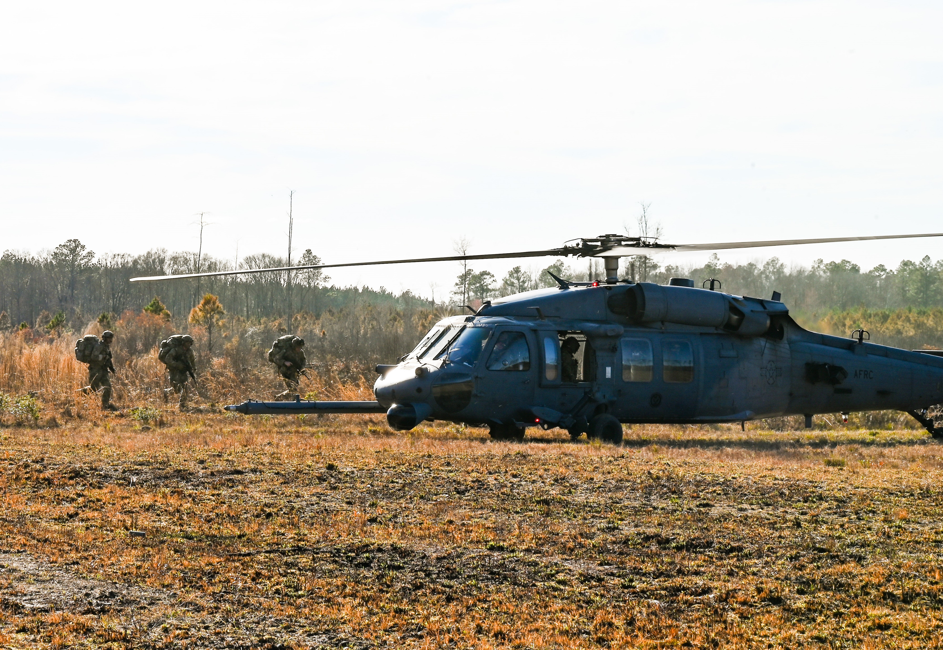
FY24 – Exercise Flying Calendar
ANG Ex – Strato Blitz
ANG SFE – Maple Thunder
ACC Ex – Raptor Dawn 24-1
ACC Ex – Guerrilla Takedown
ANG Ex – Agile Rage 24-1
ACC Ex – Combat Rescue
*
ANG Ex – Southern Strike
FY 24
USN Ex – Combat Dragon
ANG Ex – Agile Rage 24-2
ACC Ex – Strike Force
ANG Ex – Sentry Savannah 23-1
ANG EX – Steeler Surge
ANG EX – Lobo Certification
ACC EX – Raptor Dawn 24-2
ACE training objectives

Slide 13
FY25 – Exercise Flying Calendar
ANG Ex – Sentry Savannah
ACC MSN – Operation Noble Eagle
ANG Ex – Buckeye Dawn
ANG Ex – Patriot 2025
ANG Ex – Hog Rally
*
ANG Ex – Maverick Armistice
FY 25
ACC Ex – Raptor Dawn
ANG Ex – Bayou Brawl
ACC Ex – Guerilla Takedown
ACC Ex – Raptor Dawn
ANG Ex – William Tell
ACE training objectives

Slide 14
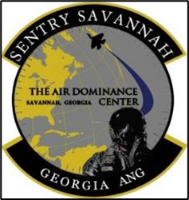
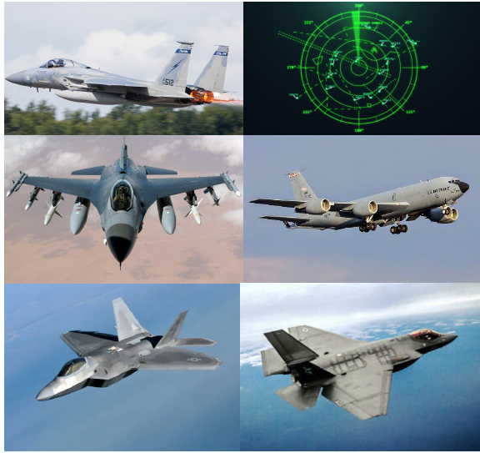
Sentry Savannah
20-31 Jan 25

Slide 15
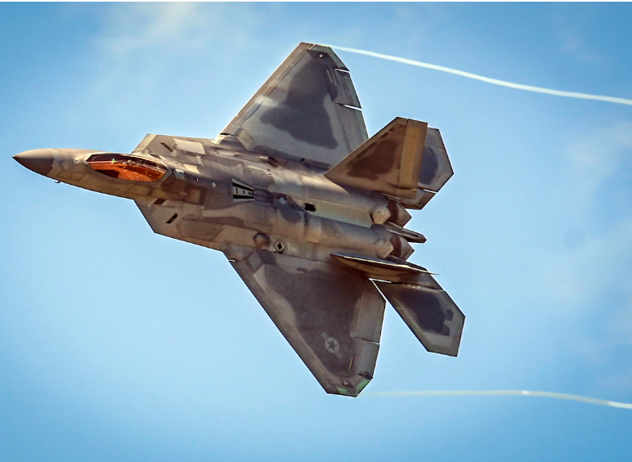
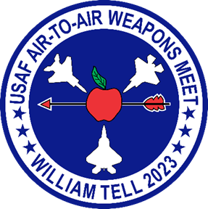
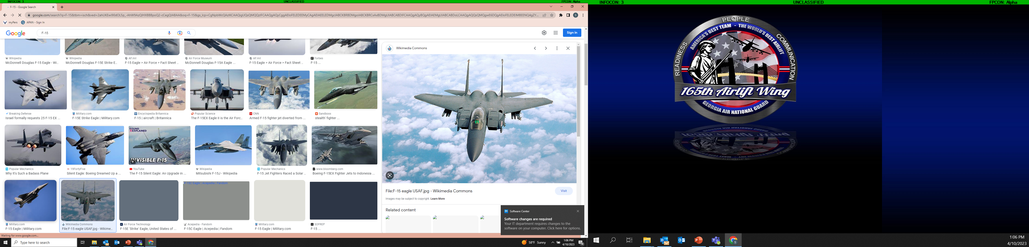
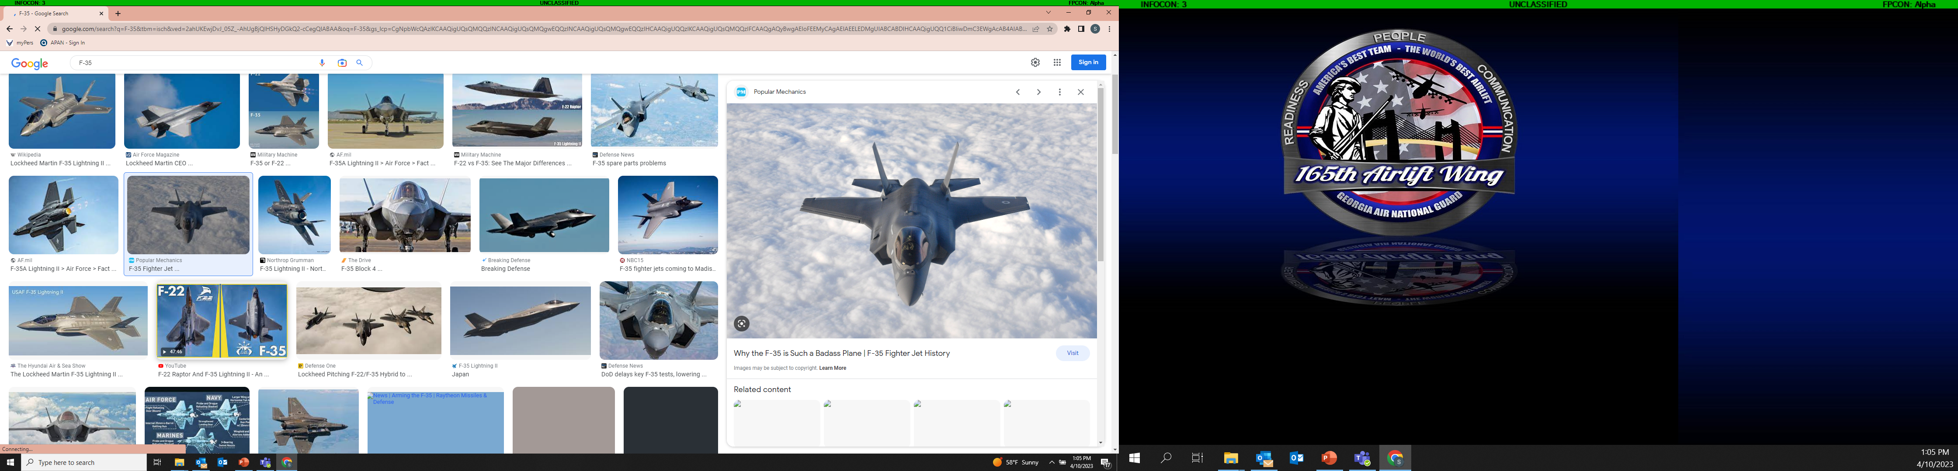
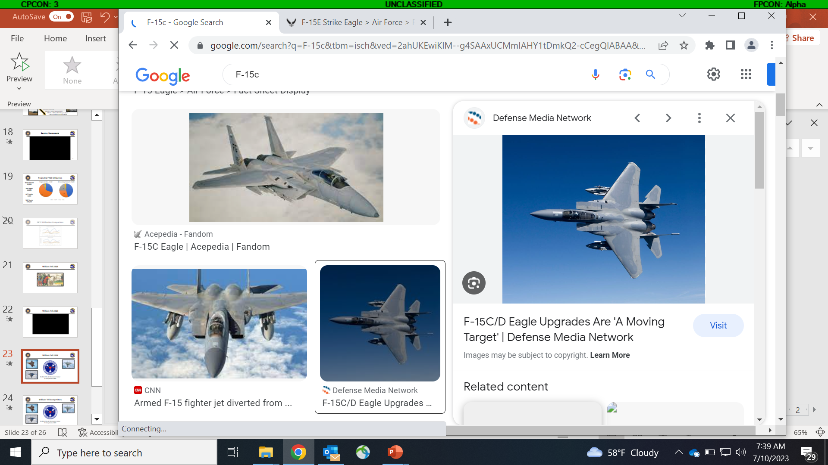
William Tell 2023
Hosted at the Air Dominance Center
9-16 September 2023

Slide 16

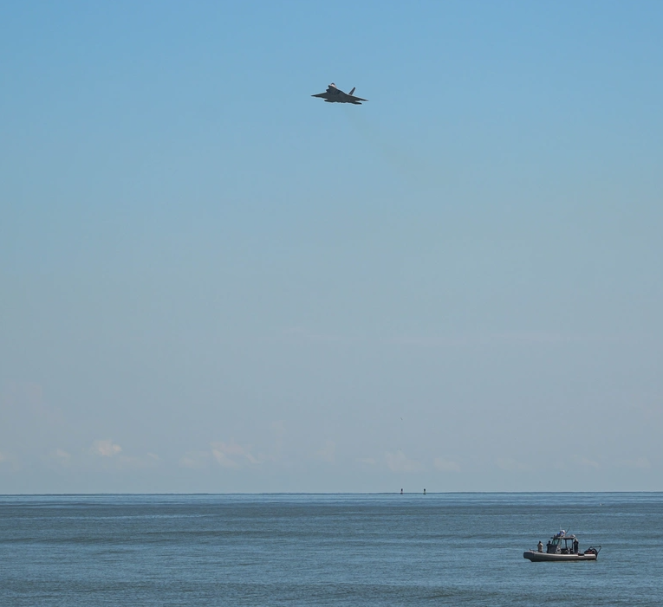


William Tell 2023
Tybee Island – F-22 Demo

Slide 17
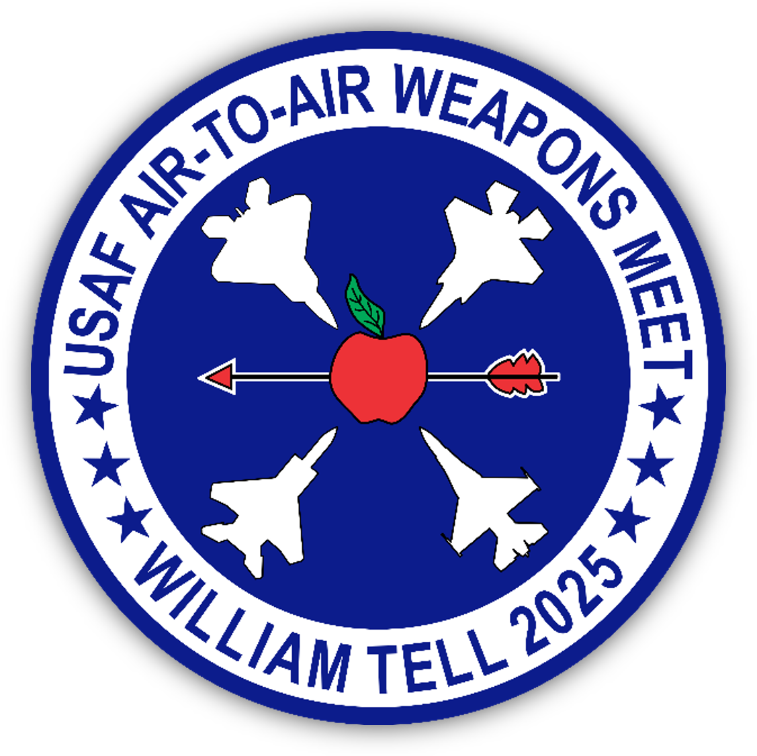
William Tell 2025
Hosted at the Air Dominance Center
8 – 18 September 2025

Slide 18
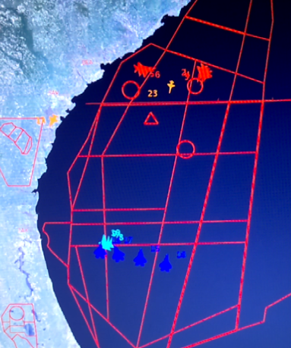
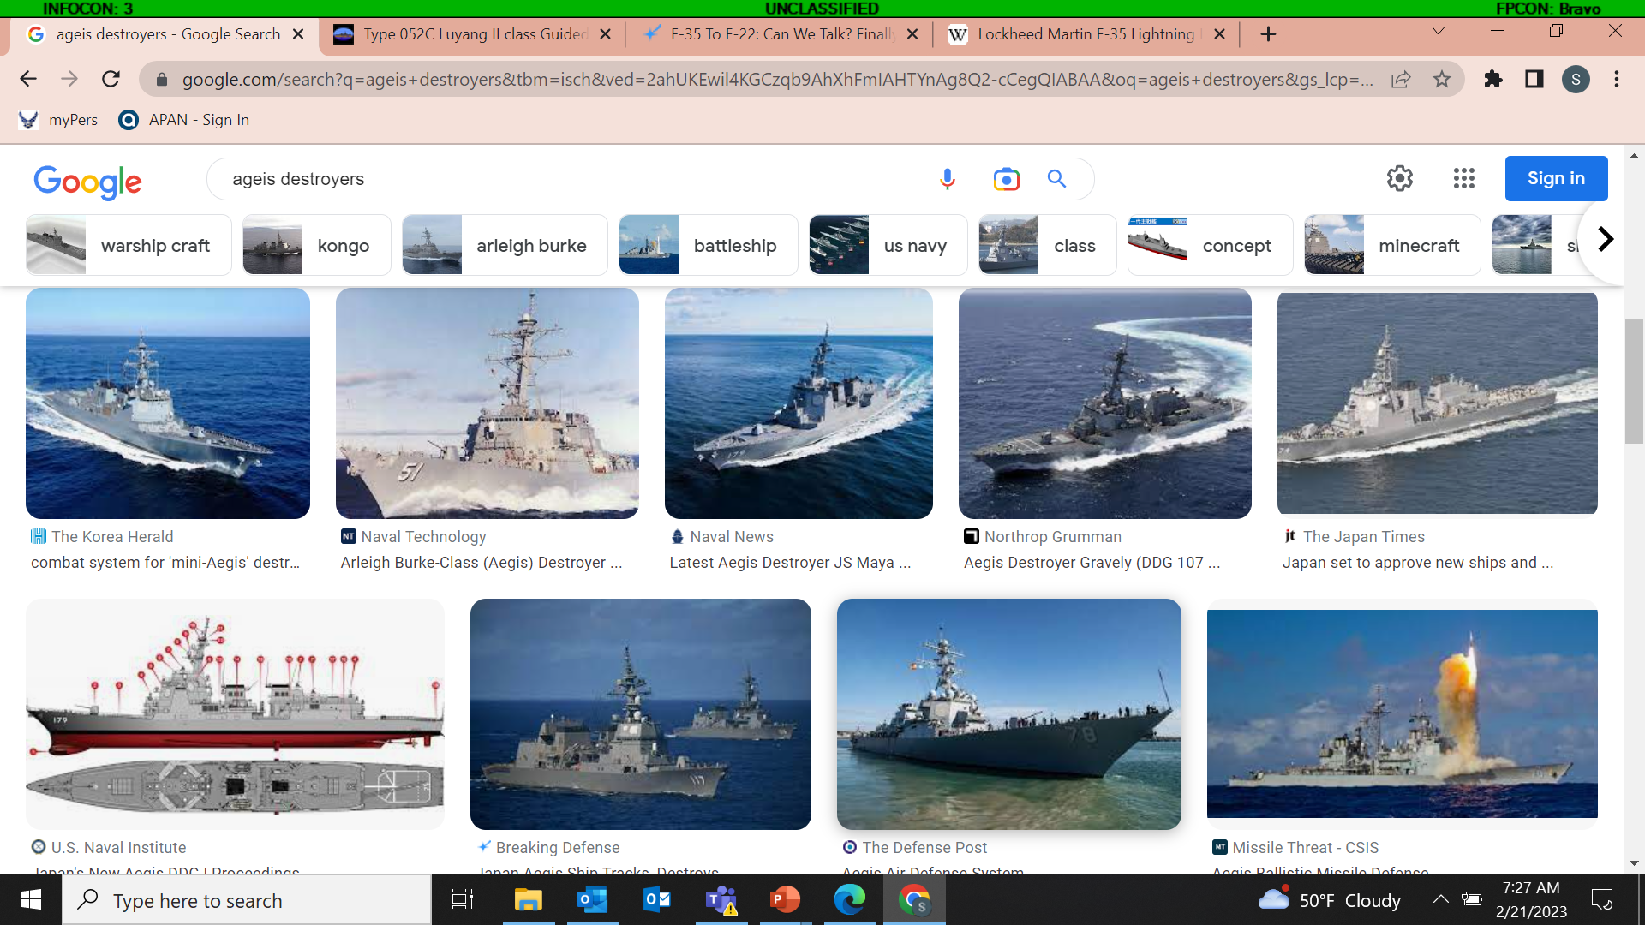
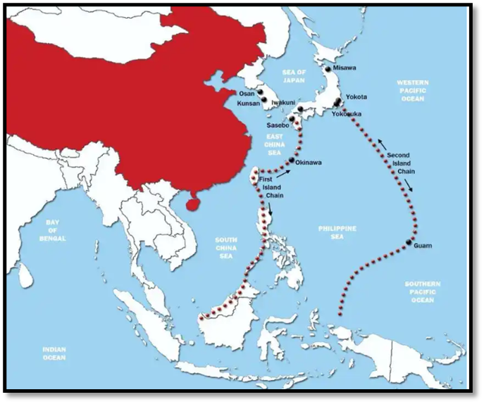
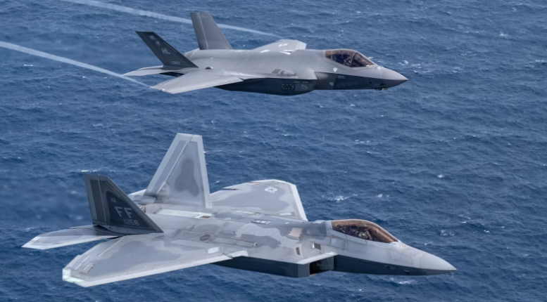
Why Savannah?

Slide 19

Questions
Col Stephen “Tracker” Thomas
stephen.thomas.36@us.af.mil
912-507-3220

